Slide 1
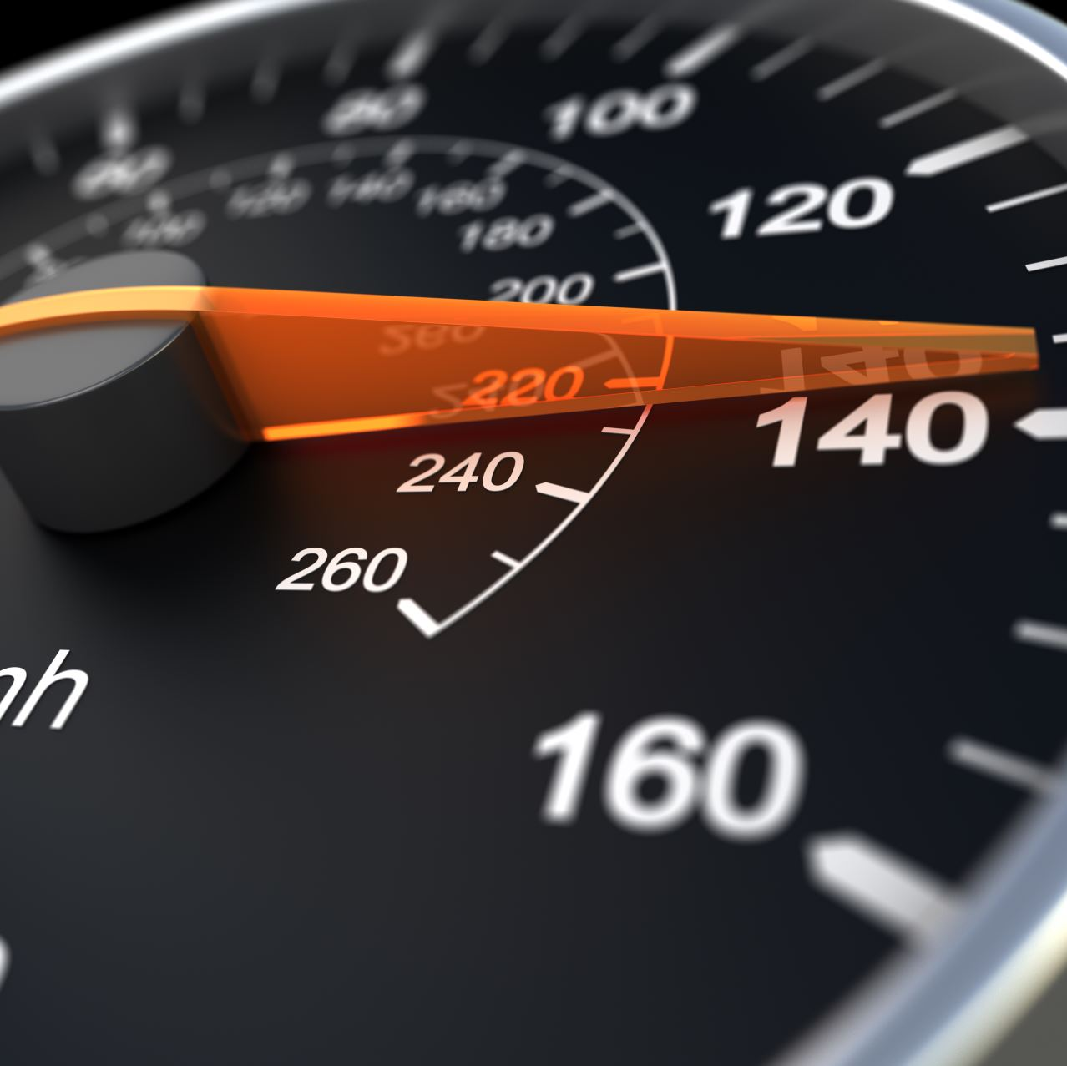
CAR FUEL PROBLEM
Ahmed Ibrahim Afify
Hassan Mohamed Kamal
Laila Mahmoud Al-Ashkar
Omar Waheed Abd-Rabo
Omnia Salama Maher

Slide 2
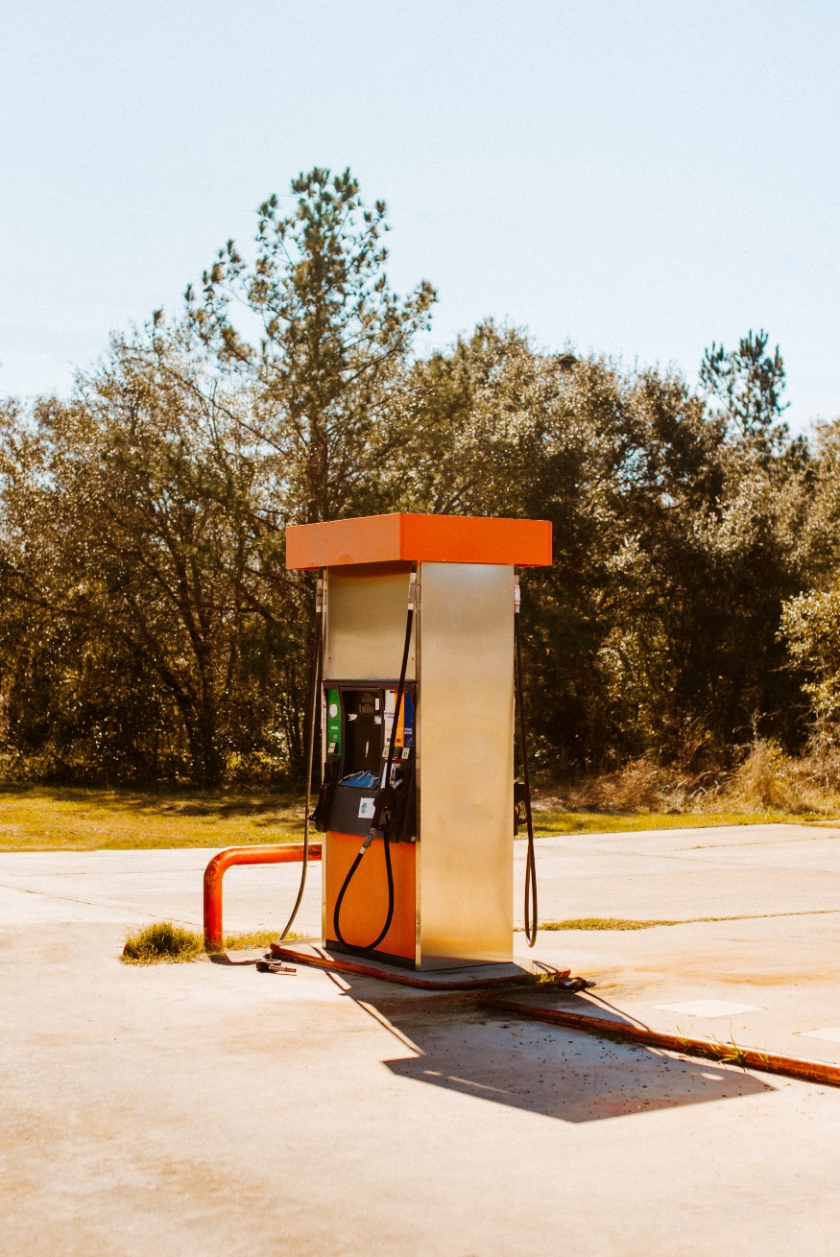
Description
Find the minimum number of refueling refills during a long journey by a car.

Slide 3
GREEDY APPROACH
Greedy approach in this problem is looking for local optimal solution in each step and wishing to reach the global optimal solution at the end.

Slide 4



GREEDY APPROACH
Tank
Location: 0
Gas: 10
Location: 10
Gas: 60
Location: 30
Gas: 40
Location: 70
Gas: 30
Location: 100
Gas: 40
Location: 140

Slide 5
GREEDY APPROACH
Tank
Location: 0
Gas: 10
Location: 10
Gas: 60
Location: 30
Gas: 40
Location: 60
Gas: 30
Location: 100
Gas: 40
Location: 140

Slide 6
GREEDY APPROACH
Tank
Location: 0
Gas: 10
Location: 10
Gas: 60
Location: 30
Gas: 40
Location: 60
Gas: 30
Location: 100
Gas: 40
Location: 140

Slide 7
GREEDY APPROACH
Tank
Location: 0
Gas: 10
Location: 10
Gas: 60
Location: 30
Gas: 40
Location: 60
Gas: 30
Location: 100
Gas: 40
Location: 140

Slide 8
GREEDY APPROACH
Tank
Location: 0
Gas: 10
Location: 10
Gas: 60
Location: 30
Gas: 40
Location: 60
Gas: 30
Location: 100
Gas: 40
Location: 140

Slide 9
GREEDY APROACH Pseudocode
out of gas position = start car fuel
while (out of gas position < target distance)
if (out of gas position < nearest gas station location) or (target > gas after fueling at last station)
the target is NOT reachable
find furthest gas station while car tank is NOT empty
increase stop times
fill up tank at that gas station.
compute out of gas position.
reached

Slide 10
GREEDY APROACH Analysis
Best case: Ω(1)
Initial gas in car is enough to reach the target. There's NO stops.
Worst case: O(n)
Car will stop at every gas station.

Slide 11
DYNAMIC PROGRAMMING APPROACH
Dynamic approach in this problem will reach optimal solution As it will visit every station to reach the optimal solution.

Slide 12
DP APPROACH
Tank
Location: 0
Gas: 10
Location: 10
Gas: 60
Location: 30
Gas: 40
Location: 70
Gas: 30
Location: 100
Gas: 40
Location: 140

Slide 13
DP APPROACH
Tank
Location: 0
Gas: 10
Location: 10
Gas: 60
Location: 30
Gas: 40
Location: 60
Gas: 30
Location: 100
Gas: 40
Location: 140

Slide 14
DP APPROACH
Tank
Location: 0
Gas: 10
Location: 10
Gas: 60
Location: 30
Gas: 40
Location: 60
Gas: 30
Location: 100
Gas: 40
Location: 140

Slide 15
DP APPROACH
Tank
Location: 0
Gas: 10
Location: 10
Gas: 60
Location: 30
Gas: 40
Location: 60
Gas: 30
Location: 100
Gas: 40
Location: 140

Slide 16
DP APPROACH
Tank
Location: 0
Gas: 10
Location: 10
Gas: 60
Location: 30
Gas: 40
Location: 60
Gas: 30
Location: 100
Gas: 40
Location: 140

Slide 17
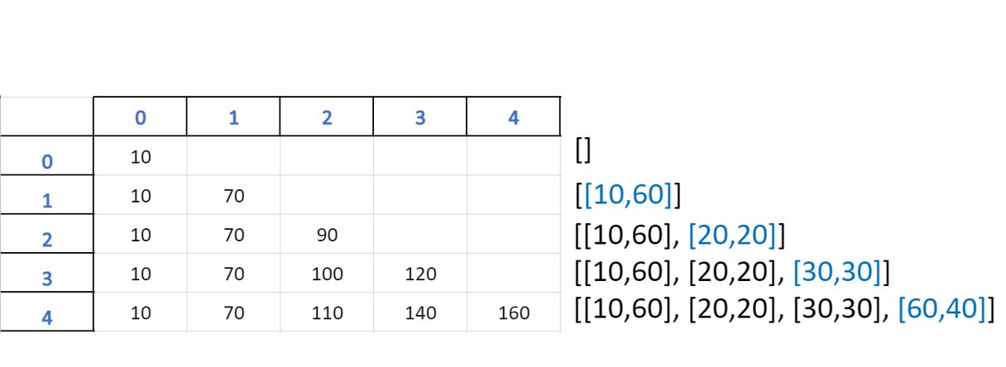
Target = 105
Start fuel = 10

Slide 18
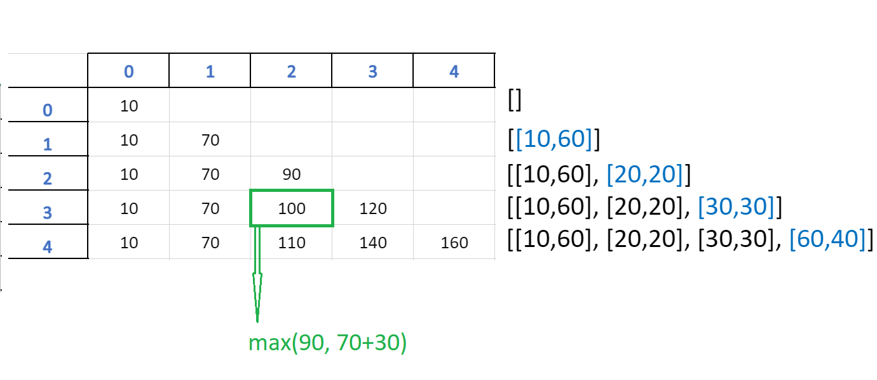
Target = 105
Start fuel = 10

Slide 19
DP APROACH Pseudocode
make list dp with zeros to store refills on it
make the first element equal to startfuel
for location in range(1, stations_num):
for capacity in range(1, station+1):
to check if the new station is reachable
if dp[location-1][capacity-1] >= stations[location-1][0] :
then:
Add the next station to the dp if no keep the the dp as it is
else
then:
print the satation and number f refills that we reached
print dp to see the progress
check if the target could be reached at one of the sataion then make the flag equal to 1
then check if the flag equal to one print number of refills needed to reach the target
and print the satation sorted to see which stations the algrothim needed to reach thetarget
if not print that it cannot be reached

Slide 20
DP APROACH Analysis
Average case: Ω(N^2):
It will calculate Available gas at Every Station to check whether to take the fuel or not then choose the stations which will be the optimal solution
Worst Case:O(N^2):
It will stop at every station to refill
Best Case:Σ(N^2):
It will have enough fuel to reach the target from the start location without enter any station

Slide 21
Priority-Queue
Looking to reach optimal solution by selecting the high giver stations.

Slide 22
DP APPROACH
Tank
Location: 0
Gas: 30
Location: 10
Gas: 40
Location: 30
Gas: 60
Location: 70
Gas: 30
Location: 100
Gas: 40
Location: 130

Slide 23
DP APPROACH
Tank
Location: 0
Gas: 30
Location: 10
Gas: 40
Location: 30
Gas: 60
Location: 70
Gas: 30
Location: 100
Gas: 40
Location: 130

Slide 24
DP APPROACH
Tank
Location: 0
Gas: 30
Location: 10
Gas: 40
Location: 30
Gas: 60
Location: 70
Gas: 30
Location: 100
Gas: 40
Location: 130

Slide 25
DP APPROACH
Tank
Location: 0
Gas: 30
Location: 10
Gas: 40
Location: 30
Gas: 60
Location: 70
Gas: 30
Location: 100
Gas: 40
Location: 130

Slide 26
Priority-Queue Analysis
Best case: Ω(1)
Initial gas in car is enough to reach the target. There's NO stops.
Worst case: o(nlog(n))
Car will stop and revisit previses stations

